Slide 1






SIEM with ELK
2ème année Génie Télécommunications et Réseaux
Final Year Project
ELK , Logstash/Filebeat , Kibana , Suricata
Presented by :
Guided by :
FATHI ISMAIL
MAJID MOHAMMED
MR . BALBOUL YOUNES

Slide 2
OUTLINE
Introduction
Definition & Literature Review
Methodology
Results
Conclusion

Slide 3
Introduction

Slide 4
What is SIEM ?
SIEM (Security Information and Event Management) is a security management system that combines data collection, analysis, and reporting.
It helps organizations identify and respond to security threats in real-time by monitoring security logs, network traffic, and other sources. SIEM enables proactive security measures and enhances overall protection for sensitive information.

Slide 5
How does SIEM work?
In the past, SIEMs needed careful management throughout the data pipeline, including data ingestion, policies, alert reviews, and anomaly analysis.
However, modern SIEMs are becoming smarter by efficiently gathering data from various sources within organizations and employing AI techniques to identify security incidents based on behavioral patterns.

Slide 6
Data collection
SIEM systems gather data through collection agents on devices, servers, network equipment, firewalls, antivirus, or via protocols like syslog forwarding, SNMP, or WMI. They can also integrate with cloud services to access log data from cloud infrastructure or SaaS applications, as well as handle non-standard data sources efficiently.

Slide 7
Data storage
Traditional SIEMs faced challenges in storing and managing large data volumes as they relied on data center storage. Consequently, only a portion of log data could be retained. However, next-generation SIEMs leverage modern data lake technology like Amazon S3 or Hadoop, enabling highly scalable and cost-effective storage. This advancement enables the retention and analysis of 100% of log data across various platforms and systems.

Slide 8
Data consolidation and correlation
A SIEM's main purpose is to bring together data and correlate logs and events from all organizational systems. It enables the connection of various data points, such as error messages, blocked connections, and failed password attempts, into meaningful security events. Analysts are notified through notifications or dashboards. Next-gen SIEMs are constantly improving in identifying real security events that need attention.

Slide 9
SIEM Features and Capabilities
Alerting
Dashboards and Visualizations
SIEM analyzes events and assists in escalating alerts to notify security staff promptly.
SIEM creates visualizations that enable staff to review event data, identify patterns, and spot deviations from standard processes or event flows.
Compliance
Automates the gathering of compliance data, producing reports that adapt to security, governance and auditing processes for standards like HIPAA, PCI/DSS, HITECH, SOX, and GDPR.
Retention
stores long-term historical data to support analysis, tracking, and reporting for compliance requirements.
Threat Hunting
Incident Response
SIEM enables security staff to run queries across multiple sources using SIEM data, apply filters, pivot the data, and proactively identify threats or vulnerabilities.
SIEM offers case management, collaboration, and knowledge sharing for security incidents, enabling quick synchronization, communication, and response by security teams.

Slide 10
Literature Review

Slide 11




Different SIEM
 | Splunk
 | Qradar
 | EXABEAM
 | ELK

Slide 12
Cybersecurity Infographics
Exabeam specializes in user behaviour analytics (UBA) and security analytics. Using machine learning algorithms, it detects anomalies and potential threats by analyzing user activity and behavior. By collecting and correlating data from logs, endpoints, and cloud services, Exabeam identifies abnormal activities and potential insider threats.
IBM QRadar is a comprehensive SIEM platform with log management, event correlation, and threat detection capabilities. It integrates with diverse data sources for real-time monitoring and analysis of security events. QRadar utilizes advanced analytics, machine learning, and rule-based detection to identify security incidents
Splunk is a versatile and scalable log management and SIEM platform. It enables organizations to collect, index, and analyze machine-generated data from various sources, including logs, events, and metrics. With real-time monitoring, alerting, visualization, and reporting capabilities, Splunk offers a user-friendly interface and a rich ecosystem of apps and integrations.

Slide 13
ELK
ELK, also called the ELK Stack or Elastic Stack, is an open-source log management and analytics platform. It comprises three core components: Elasticsearch (distributed search and analytics engine), Logstash (data collection and processing pipeline), and Kibana (data visualization and dashboarding tool). ELK allows organizations to collect, parse, index, search, and visualize log data from various sources. Its flexibility and customization options make it favored by developers and organizations with specific log management requirements.

Slide 14
Why did we choose to work with ELK
Open-source nature
Search and analytics capabilities
Flexibility and customization
Visualization and dashboarding
Scalability
Extensive ecosystem
Notes:
Open-source nature: ELK is an open-source platform, which means the software is freely available for use and can be modified and customized according to specific requirements. This openness fosters innovation, encourages community contributions, and allows organizations to tailor the platform to their specific needs.
Flexibility and customization: ELK provides a high level of flexibility and customization options. Each component of the ELK stack can be configured and extended to meet specific log management and analytics requirements. This enables organizations to design a solution that fits their unique needs, ensuring they have complete control over data ingestion, processing, indexing, and visualization.
Scalability: ELK is designed to scale horizontally, allowing organizations to handle large volumes of data efficiently. Elasticsearch, the core component of ELK, is a distributed search and analytics engine that can be deployed across multiple nodes to handle increasing data loads and provide high availability. This scalability makes ELK suitable for organizations dealing with massive amounts of log data.
Search and analytics capabilities: Elasticsearch, the heart of ELK, is renowned for its powerful search and analytics capabilities. It provides near real-time search results, complex query capabilities, full-text search, and aggregations across large datasets. This makes it easy to perform advanced searches, analyze log data, and extract valuable insights from the collected logs.
Visualization and dashboarding: Kibana, the visualization component of ELK, offers a user-friendly interface for creating interactive visualizations, dashboards, and reports. It allows users to visualize log data in various forms, such as charts, graphs, maps, and tables. Kibana's extensive visualization capabilities make it easier to understand complex data and identify trends, patterns, and anomalies.
Extensive ecosystem: ELK has a rich ecosystem of plugins, integrations, and community-contributed modules that extend its capabilities. It integrates with various data sources, including logs, metrics, and security events, and offers plugins for specific use cases like monitoring, alerting, machine learning, and more. This ecosystem ensures that ELK can be integrated into existing systems and workflows seamlessly.

Slide 15
Methodology

Slide 16
Tools Definitions
Suricata is an open source network intrusion detection and prevention system (IDS/IPS) that can monitor network traffic for signs of intrusion or suspicious activity. It uses signature-based detection and anomaly-based detection to identify potential threats,
Logstash is an open source data processing pipeline that allows users to ingest, transform, and ship data from various sources to a destination like Elasticsearch. It provides a wide range of plugins to support various data sources, filters, and output options.
Elasticsearch is a distributed, open source search and analytics engine designed for handling large volumes of data. It provides a scalable search and analytics engine, with real-time search and analytics capabilities, making it useful for building applications with full-text search features and for analyzing large datasets.
Kibana is an open source data visualization platform that allows users to analyze and visualize large datasets. It integrates with Elasticsearch, providing a user-friendly interface for exploring and visualizing data, building dashboards and creating reports.

Slide 17

Filebeat is a lightweight log shipper tool by Elastic that collects and forwards log data from diverse sources. It monitors log files in real-time, applies filters and transformations, and sends log events to Elasticsearch or Logstash for indexing and analysis. It supports various log formats, handles multiline logs, and offers scalability. Filebeat simplifies log data collection, making it an integral part of log management and analysis workflows in the Elastic Stack.
We are going to use Filebeat instead of Logstash since it needs more resources compared to Filebeat

Slide 18



The Log Flow
monitor network traffic and analyze it for potential security threats and generate alerts and log events
servers, applications, and endpoints generate log data
applies filters and transformations as necessary to prepare the data for analysis. This may include adding metadata to the log data, filtering out noise, and removing unnecessary fields.
storage and indexing
visualize and analyze the log data
search and analyze the log data

Slide 19
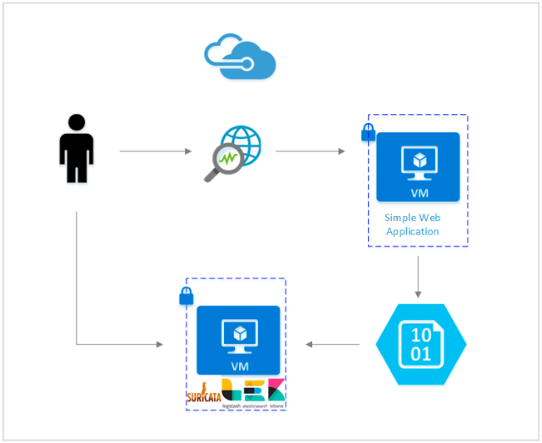
Implementation
We used two Virtual machines to implement our system , one for the SIEM and one for the client :
Vm1 : SIEM SERVER (ubuntu-22.04.1-live-server)
Vm2 : Client (ubuntu-22.04-desktop)
We will install all tools in the SIEM server because of our limited recourses .

Slide 20



VMware
SIEM SERVER
CLIENT
Installing & configurating Suricata
Understanding Suricata Signatures
Installing ElasticSearch & Kibana
Installing FileBeat
Installing & configurating Suricata
Installing FileBeat

Slide 21
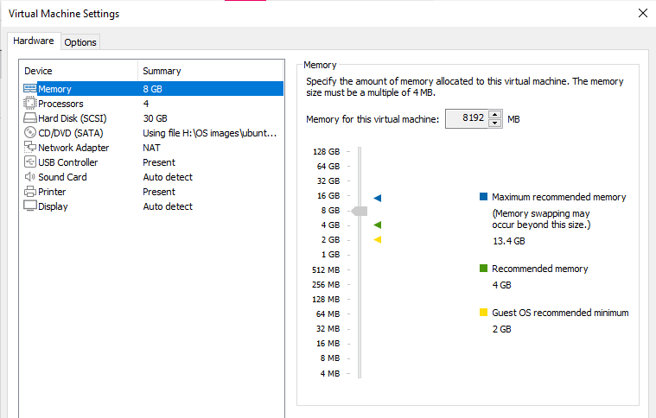
SIEM SERVER
Vmware configuration
RAM : 8 GB
CPU : 2
Storage : 30 GB
Network configuration : NAT

Slide 22
SIEM SERVER
Installing and configurating Suricata :
Add the Open Information Security Foundation’s (OISF) software repository information to your Ubuntu system. We can use the add-apt-repository command to do this.
2. install the suricata package using the apt command:
3. Start and Stop Suricata using the systemctl command :
We will keep it stopped until edit and test the configuration file

Slide 23
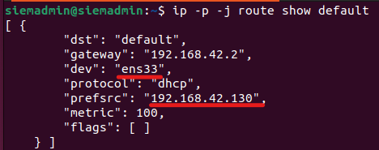
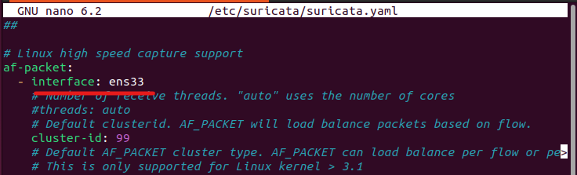
SIEM SERVER
The configuration file : /etc/suricata/suricata.yaml
Add the interfaces that you would like Suricata to inspect traffic on (by default is eth0) , we will add our interface .
We used nano command to modify our configuration file :

Slide 24
SIEM SERVER
By default the Suricata package includes a limited set of detection rules (in the /etc/suricata/rules directory), so turning Suricata on at this point would only detect a limited amount of bad traffic. Suricata includes a tool called suricata-update that can fetch rulesets from external providers.
We will run it as follows to download an up to date ruleset for your Suricata server :
suricata-update will fetched the free Emerging Threats ET Open Rules, and saved them to Suricata’s /var/lib/suricata/rules/suricata.rules file .
Suricata signatures/Rules ?
How can we create our own rules to suit our network’s requirements

Slide 25
Understanding Suricata Signatures
the Structure :
Action
Header
Options
Action
Header
Options
An Action to take when traffic matches the rule :
Pass : passing packets without alerts
Drop : stop processing the packet and generate an alert
Reject : drop the matching packet.
Alert : Suricata will generate an alert and log it for further analysis.
header section that describes the network protocol, source and destination IP addresses, ports, and direction of traffic .
<PROTOCOL> <SOURCE IP> <SOURCE PORT> -> <DESTINATION IP> <DESTINATION PORT>
which specify things like the Signature ID (sid), log message, regular expressions that match the contents of packets, classification type, and other modifiers that can help narrow identify legitimate and suspicious traffic.

Slide 26
Understanding Suricata Signatures
Example :
This signature would make Suricata alert on all incoming SSH packets from any network that are destined for us (our ip : 192.168.42.130) , that are not destined for port 22 .
the msg option with a value of SSH traffic detected on non-SSH port explaining what the alert is about .
Running Suricata :

Slide 27
SIEM SERVER
SIEM SERVER
Installing Elasticsearch and Kibana :
The tow first lines of commands are for : adding the Elastic GPG key to our server and adding the Elastic source list to the sources.list.d directory, where apt will search for new sources .
After that we update our server’s package index and we installed Elasticsearch and Kibana

Slide 28
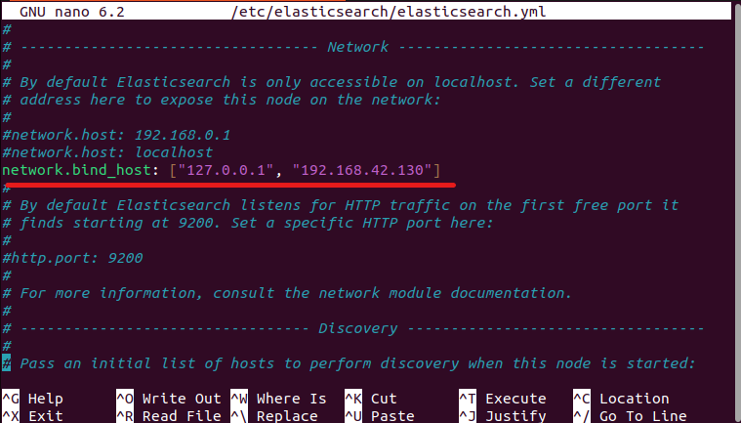
SIEM SERVER
SIEM SERVER
/etc/kibana/kibana.yml
/etc/elasticsearch/elasticsearch.yml
/etc/filebeat/filebeat.yml
We will do our modifications on those files :
Configuring Elasticsearch Networking
We uncomment the indicated line and we add our privet IP :
in all next sections our Privet IP is :
192.168.42.130

Slide 29

SIEM SERVER
SIEM SERVER
We add the two lines below at the end of file
The discovery.type setting allows Elasticsearch to run as a single node, as opposed to in a cluster of other Elasticsearch servers. The xpack.security.enabled setting turns on some of the security features that are included with Elasticsearch.
Firewall rules :
Finally,we add firewall rules to ensure our Elasticsearch server is reachable on its private network interface :
Start Elasticsearch :

Slide 30
SIEM SERVER
Configuring Elasticsearch Passwords :
Now that we have enabled the xpack.security.enabled setting, we need to generate passwords for the default Elasticsearch users. Elasticsearch includes a utility in the /usr/share/elasticsearch/bin directory that can automatically generate random passwords for these users.
Those users are for authentication purpose for Kibana and Filebeats , we can use the utlilty one time for that , we saved the result in a separate file to save it .

Slide 31
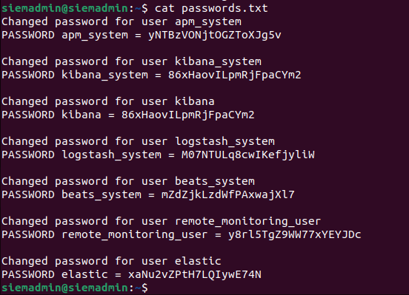
SIEM SERVER
Output :
ELK is DONE , Now will configurate Kibana’s network settings and its xpack security module.

Slide 32
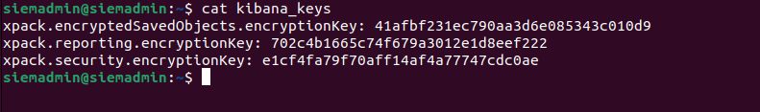
SIEM SERVER
Configuring Kibana
We configured Elasticsearch to listen for connections on our Elasticsearch server’s private IP address. we will need to do the same for Kibana ;
First we will enable Kibana’s xpack security functionality by generating some secrets that Kibana will use to store data in Elasticsearch. Then we will configure Kibana’s network setting and authentication details to connect to Elasticsearch.
Output :

Slide 33

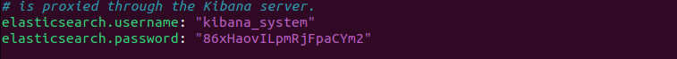
SIEM SERVER
Now we will do three things :
Add the xpack keys at the end of the configuration file
Configuring Kibana Networking
Configuring Kibana Credentials
Start Kibana :

Slide 34
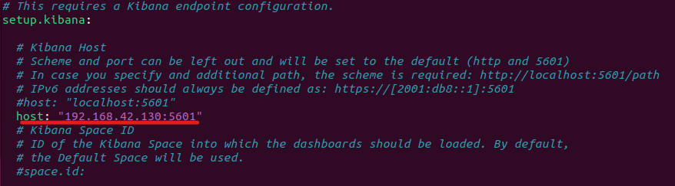
SIEM SERVER
installing Filebeat
this line points to our Kibana instance’s privite IP address and port , This change will ensure that Filebeat can connect to Kibana in order to create the various SIEM indices, dashboards, and processing pipelines in Elasticsearch to handle your Suricata logs.

Slide 35
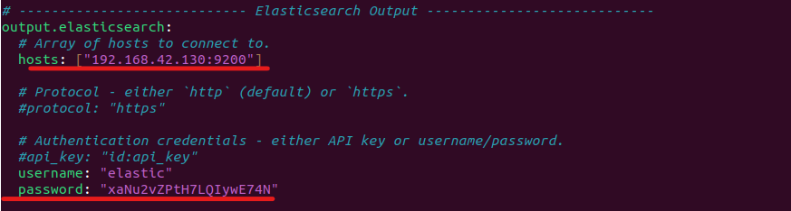
SIEM SERVER
We add also Elasticsearch information :
Now we must enable Filebeat’s built-in Suricata module with the following command :
Now that Filebeat is configured to connect to Elasticsearch and Kibana, with the Suricata module enabled, the next step is to load the SIEM dashboards and pipelines into Elasticsearch.
Run the filebeat setup command. It may take a few minutes to load everything :
& Start :

Slide 36
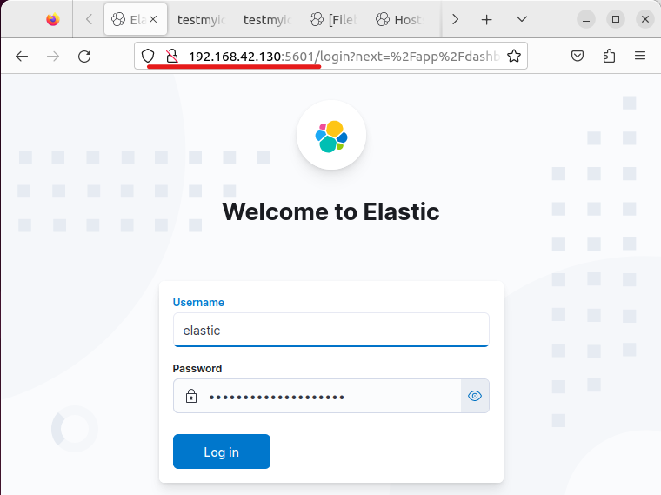
We use our privet ip with the port of kibana to access it , with using the elastic user credential .

Slide 37
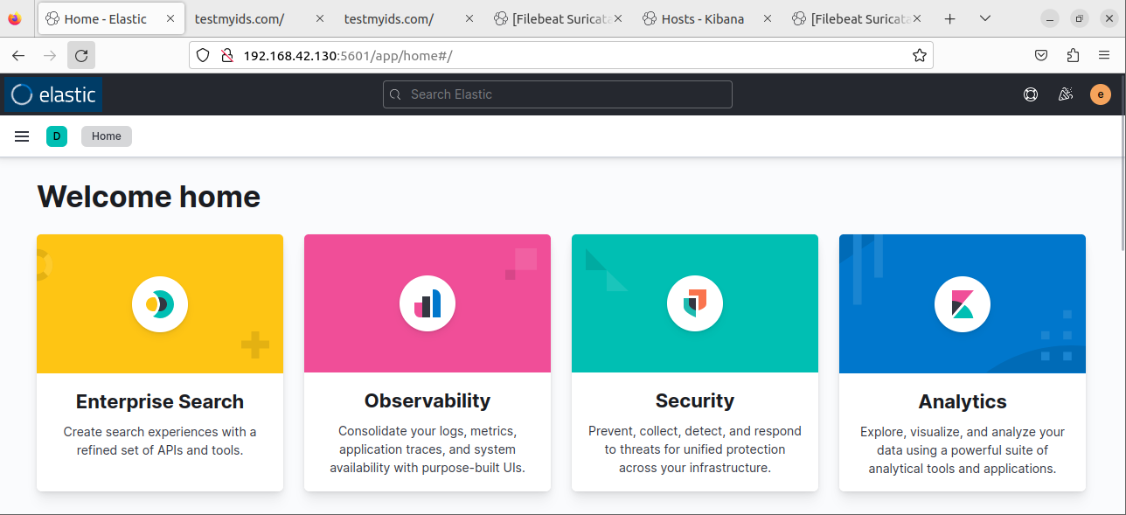
This is the home page with different Kibana’s functions

Slide 38
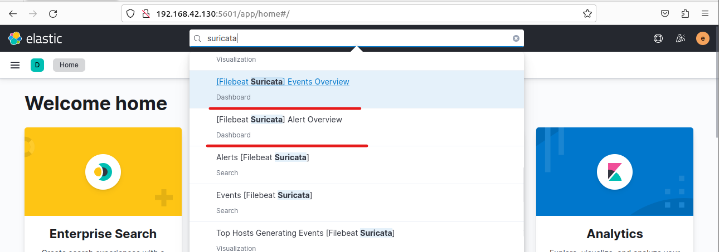
We use the search input to search Suricata dashboard

Slide 39
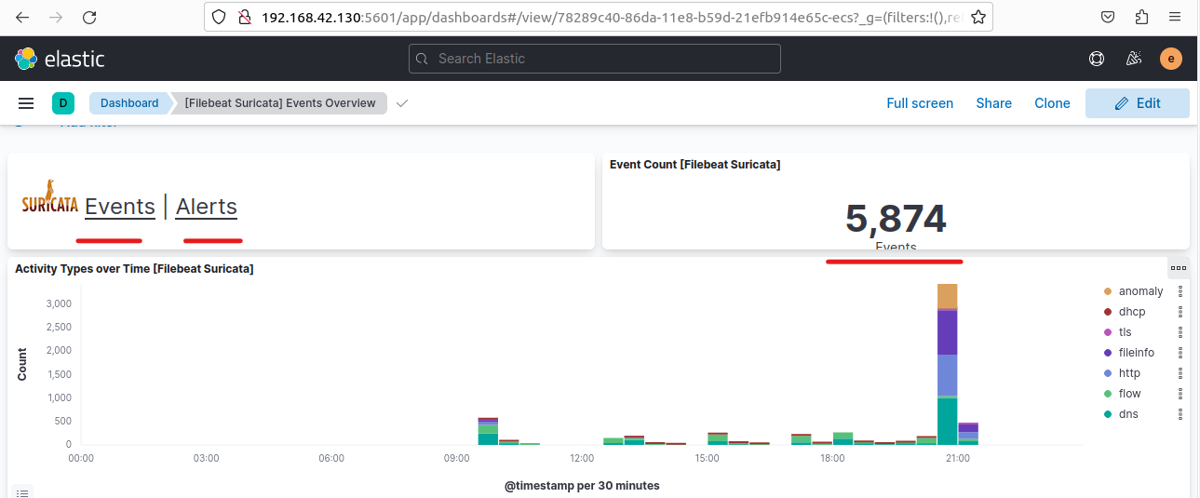
Events data

Slide 40
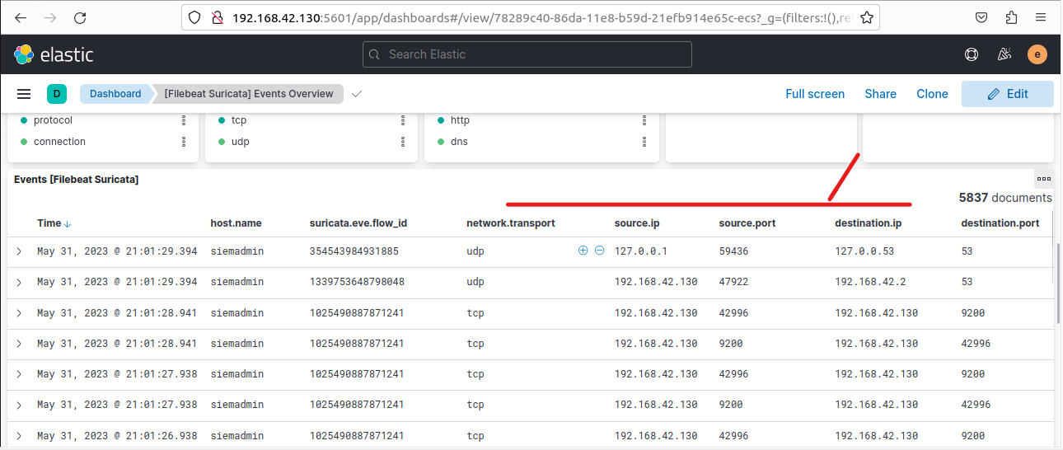
Events data

Slide 41
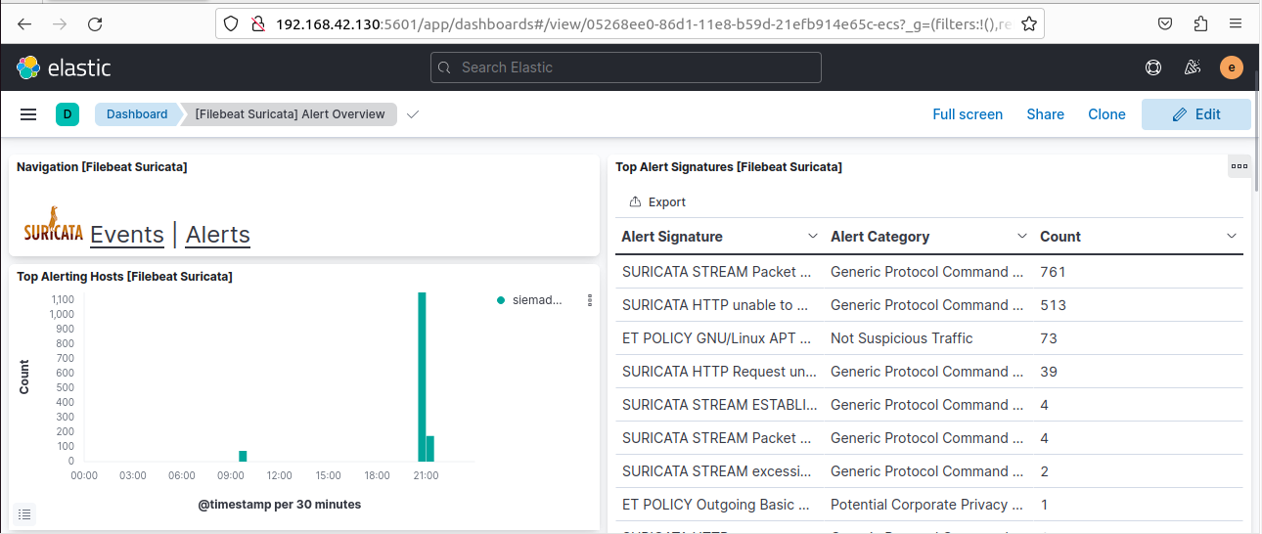
Alerts data

Slide 42
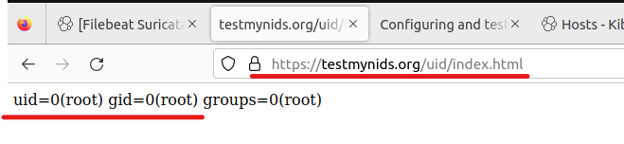
Rule :
We use this domain to test our rule , any packet use https and his content contain uid=0(root) suricata will alert us , and we will see the alert in kabana :
we sent a request using curl command from terminal or using a browser in oue case we used Firefox

Slide 43
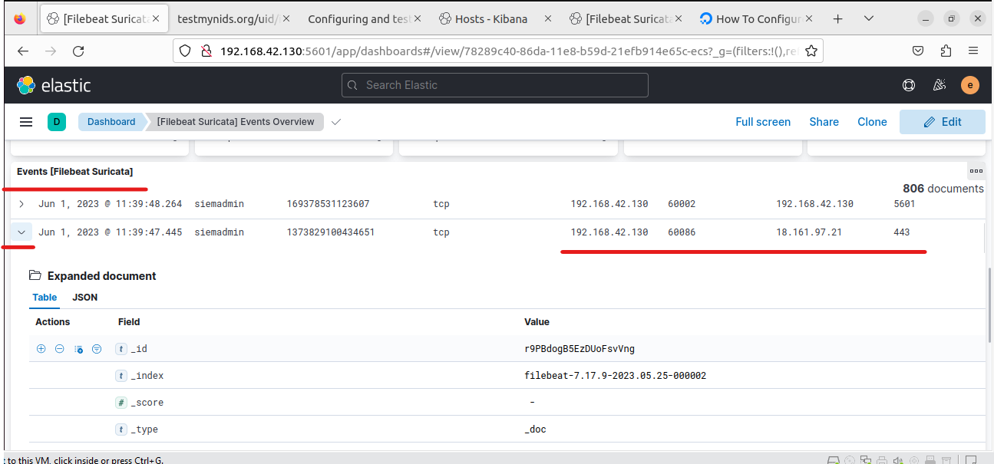
we will find an event in our Event Overview , we expand the event and we will see more data about it , but we need an alert , let’s see the alert section .

Slide 44
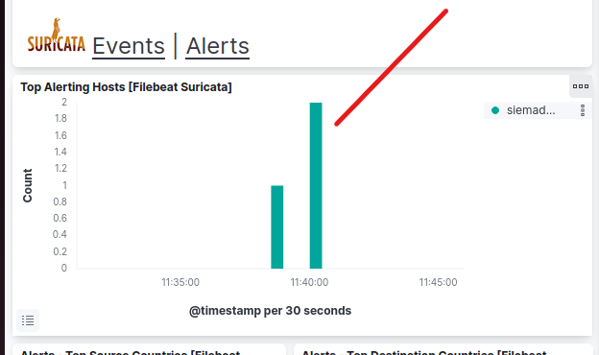
New alert appear we will see his expanded document

Slide 45
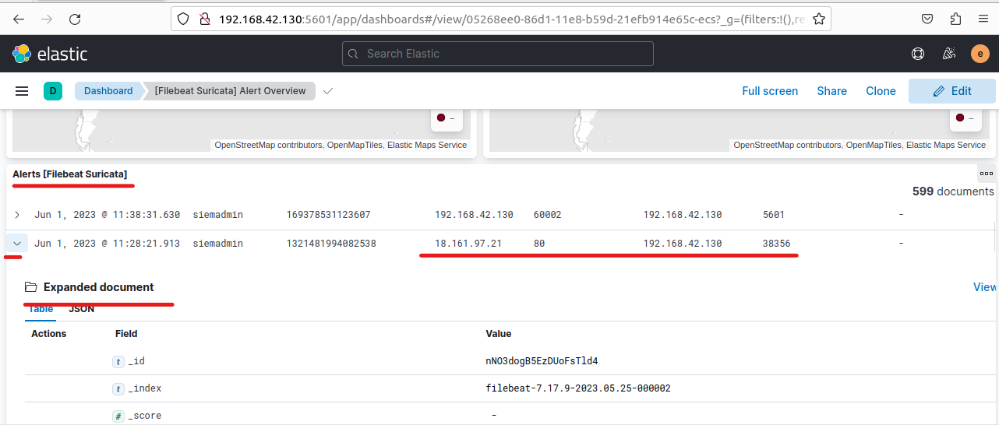

Slide 46
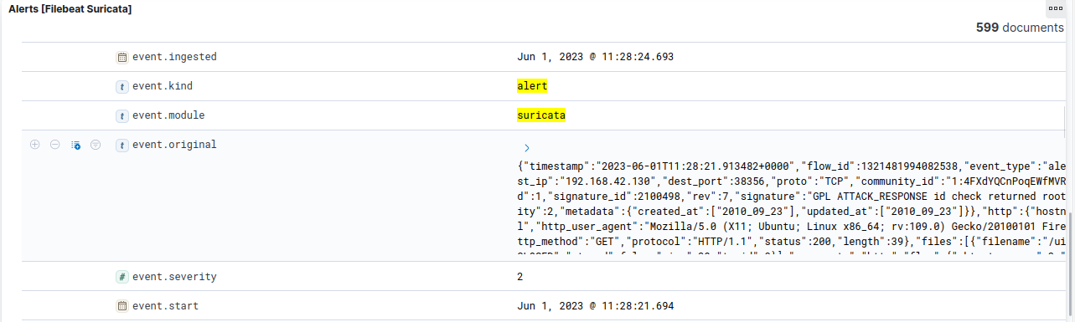
This is an alert event generated by suricata

Slide 47
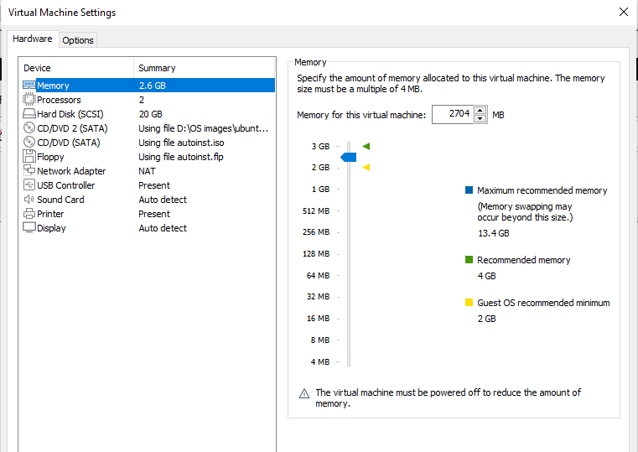
SIEM CLIENT
Vmware configuration
RAM : 2.5 GB
CPU : 2
Storage : 20 GB
Network configuration : NAT

Slide 48
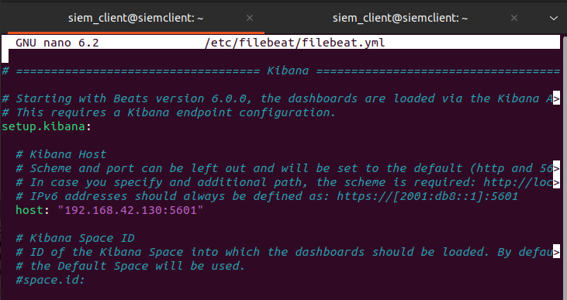
SIEM CLIENT
We installed filebeat with the same commands used with SIEM SERVER
We add the SIEM server’s IP

Slide 49
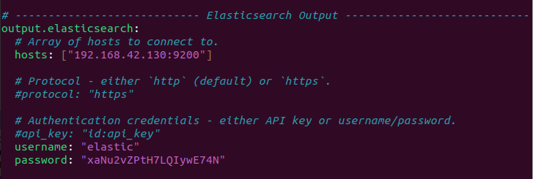
SIEM CLIENT
And we use the following modifications in the Elasticsearch Output

Slide 50

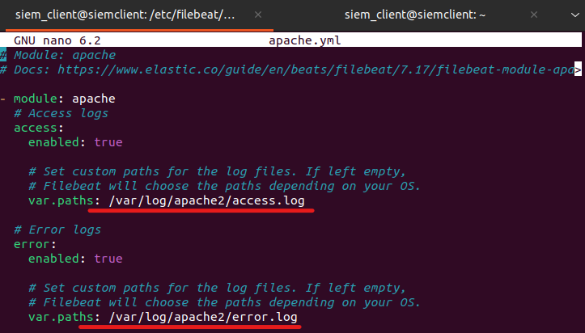
SIEM CLIENT
We installed an apache server in our client machine , and we modify the predefined module in filebeat configuration to collect logs from the apache’s Logs

Slide 51
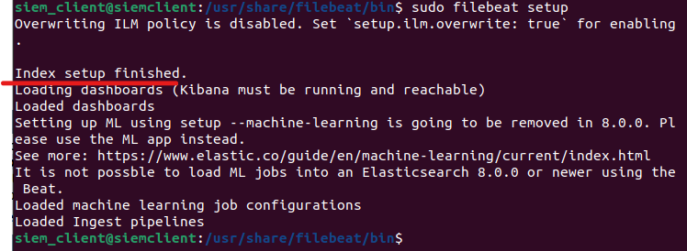
SIEM CLIENT
Now we load the information to our Elasticsaerch server with this command .
The output

Slide 52
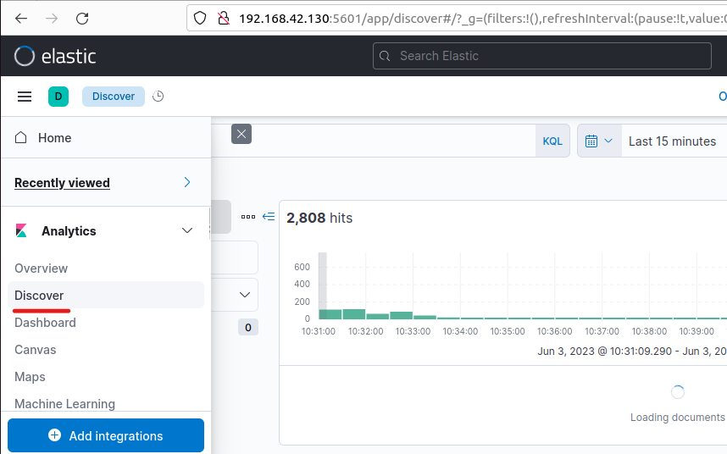
SIEM SERVER
In the Discover Part we will find the Filebeat index , where we will have all the Logs sended from our client usinf filebeat

Slide 53
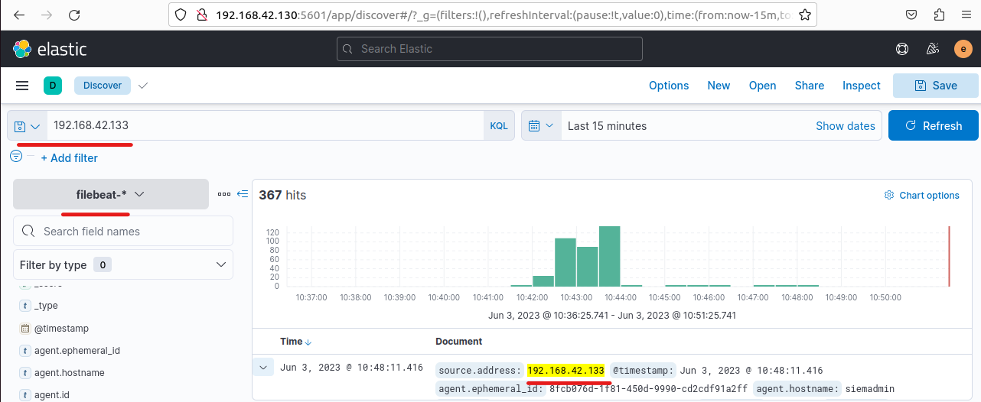

Slide 54
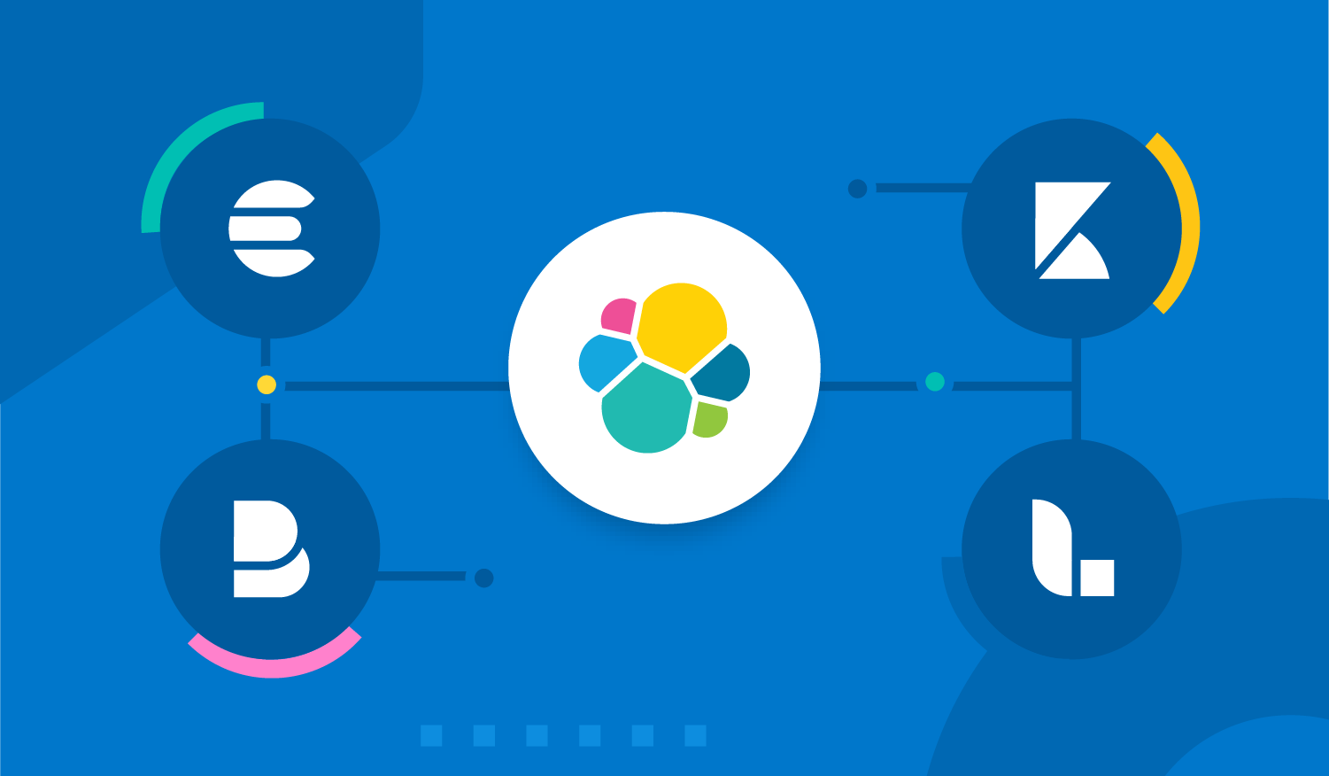
Conclusion
In summary, We highlighted the importance of SIEM solutions in modern cybersecurity practices and showcased the capabilities of ELK stack in providing a scalable and flexible platform for log management and security analytics.
There is more functionalities and capabilities with these powerful tools including the use of machine learning to improve the level of scanning and analyzing , and we can also develop our dashboards to respond to our needs .

Slide 55
Thank you

